Slide 1
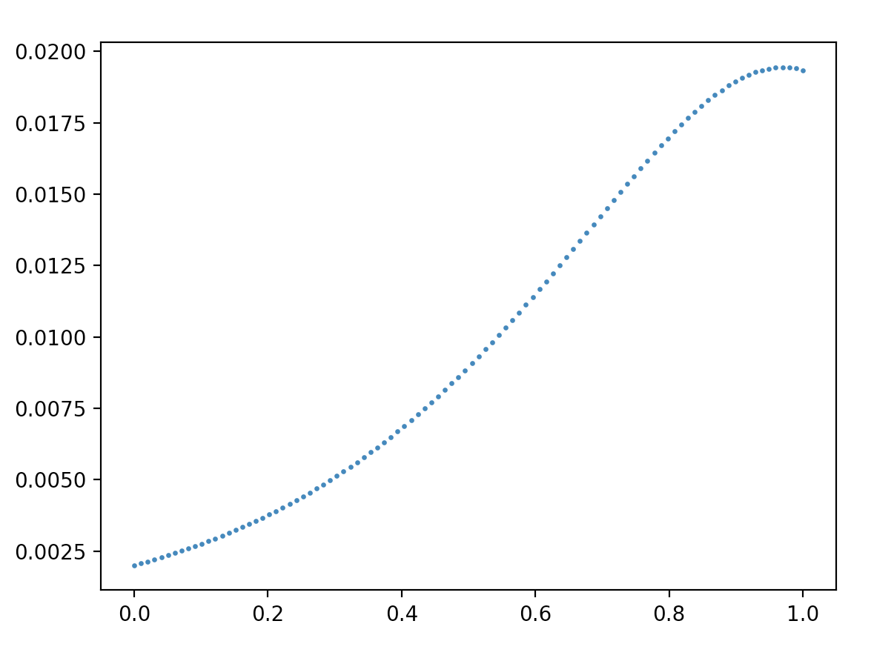
Probability Mass
Legally Blind
Ability to See (a)
Standard Vision

Slide 2
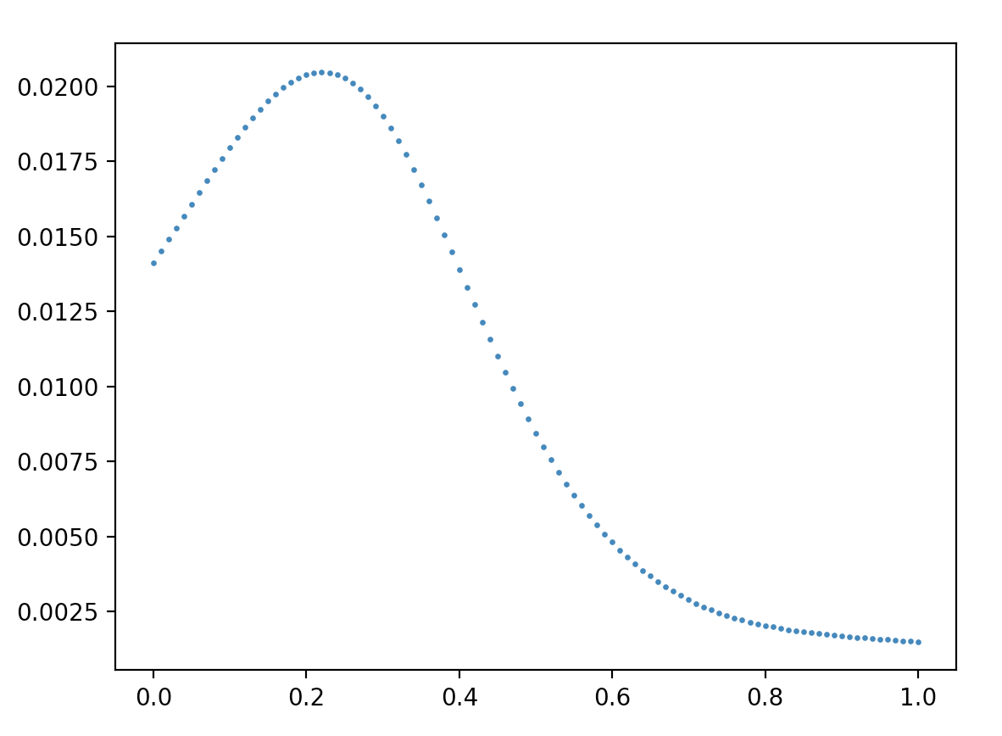
Probability Mass
Legally Blind
Ability to See (a)
Standard Vision

Slide 3
a | P(A=a) |  | a | P(A=a) | … |  | a | P(A=a)
0.00 | 0.00198 |  | 0.20 | 0.00372 |  |  | 0.80 | 0.01684
0.01 | 0.00205 |  | 0.21 | 0.00384 |  |  | 0.81 | 0.01708
0.02 | 0.00211 |  | 0.22 | 0.00396 |  |  | 0.82 | 0.01731
0.03 | 0.00218 |  | 0.23 | 0.00408 |  |  | 0.83 | 0.01753
0.04 | 0.00225 |  | 0.24 | 0.00421 |  |  | 0.84 | 0.01774
0.05 | 0.00233 |  | 0.25 | 0.00434 |  |  | 0.85 | 0.01795
0.06 | 0.0024 |  | 0.26 | 0.00447 |  |  | 0.86 | 0.01814
0.07 | 0.00248 |  | 0.27 | 0.00461 |  |  | 0.87 | 0.01832
0.08 | 0.00256 |  | 0.28 | 0.00475 |  |  | 0.88 | 0.01848
0.09 | 0.00264 |  | 0.29 | 0.00489 |  |  | 0.89 | 0.01864
0.10 | 0.00273 |  | 0.30 | 0.00504 |  |  | 0.90 | 0.01877
0.11 | 0.00281 |  | 0.31 | 0.00519 |  |  | 0.91 | 0.0189
0.12 | 0.0029 |  | 0.32 | 0.00535 |  |  | 0.92 | 0.019
0.13 | 0.00299 |  | 0.33 | 0.00551 |  |  | 0.93 | 0.01909
0.14 | 0.00309 |  | 0.34 | 0.00567 |  |  | 0.94 | 0.01916
0.15 | 0.00319 |  | 0.35 | 0.00584 |  |  | 0.95 | 0.01921
0.16 | 0.00329 |  | 0.36 | 0.00601 |  |  | 0.96 | 0.01924
0.17 | 0.00339 |  | 0.37 | 0.00619 |  |  | 0.97 | 0.01925
0.18 | 0.0035 |  | 0.38 | 0.00637 |  |  | 0.98 | 0.01924
0.19 | 0.00361 |  | 0.39 | 0.00655 |  |  | 0.99 | 0.01921
…

Slide 4
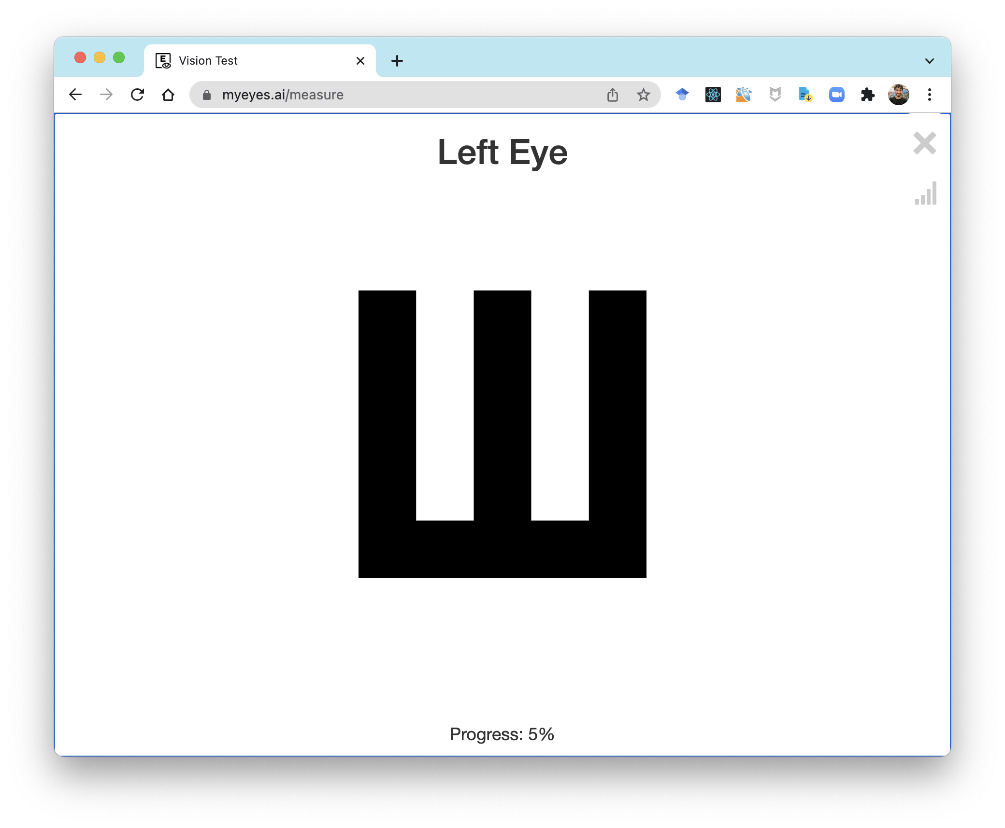
Font size 0.7
User: wrong

